Slide 1


Athletics Vocabulary
force
rotation
trajectory
compete
momentum
Continuous pace
transfer of weight

Slide 2
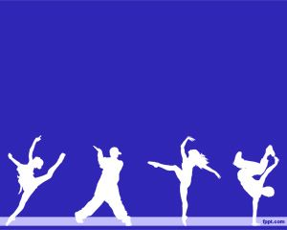

Dance Vocabulary
structure
phrase
fluently
contrast
choreograph
connect

Slide 3

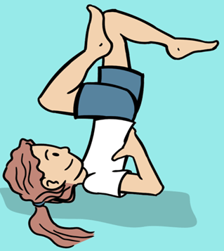
Gymnastics Vocabulary
formation
momentum
stability
counter balance
inverted
counter tension

Slide 4

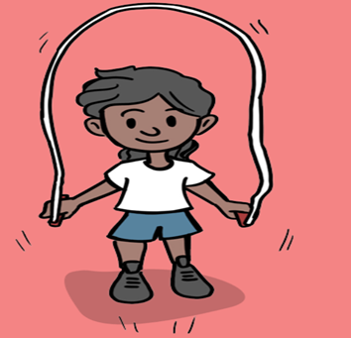
Fitness Vocabulary
continuous
measure
record
analyse
flexibility
generate force

Slide 5


OAA Vocabulary
boundaries
location
Critical thinking
strategy
Co-operatively

Slide 6

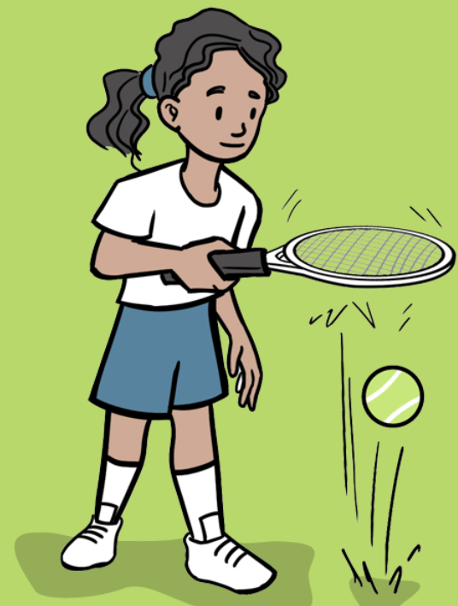
Tennis Vocabulary

Slide 7


Rounders Vocabulary

Slide 8


Swimming Vocabulary
breaststroke
crawl
backstroke
propel
Flutter kick
survival
submersion
synchronised
endurance
Treading water

Slide 9
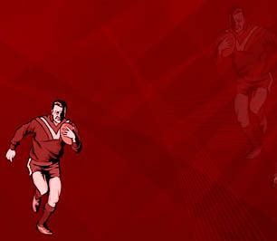

Tag Rugby Vocabulary

Slide 10
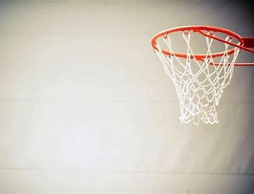
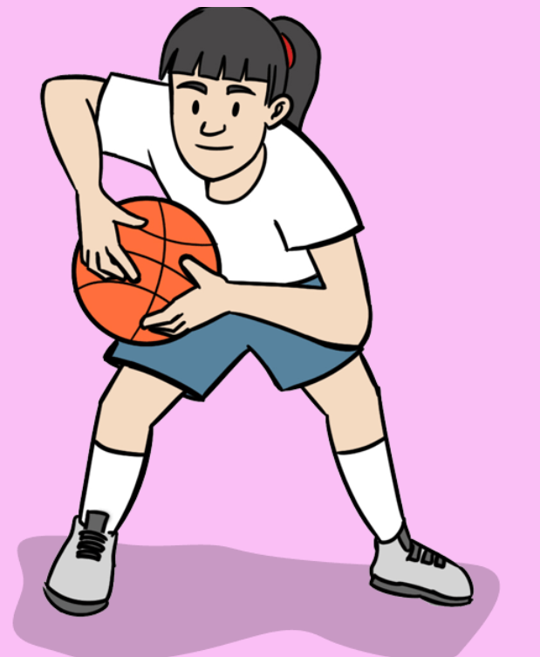
Basketball Vocabulary

Slide 11
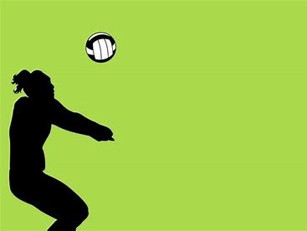

Volleyball Vocabulary

Slide 12
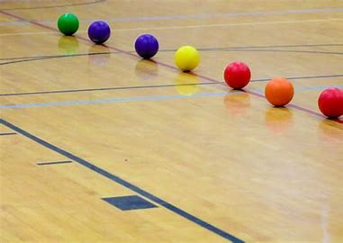
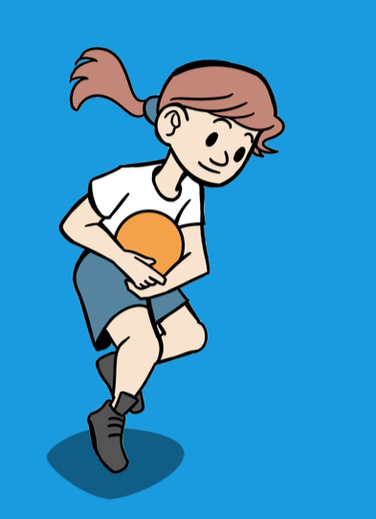
Dodeball Vocabulary

