Slide 1

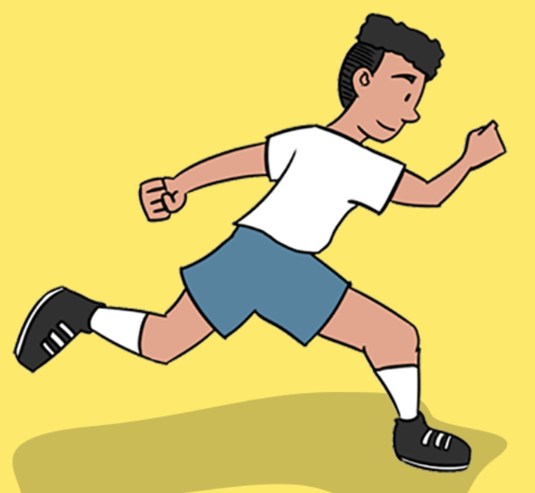
Athletics Vocabulary
technique
Up sweep
down sweep
flight
rhythm
stride

Slide 2
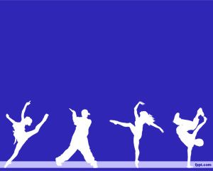
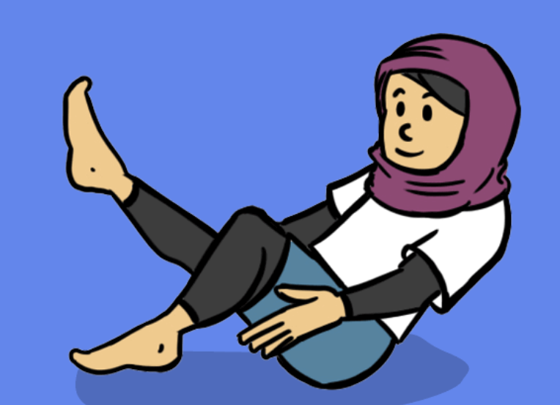
Dance Vocabulary
formation
canon
performance
posture
relationship

Slide 3
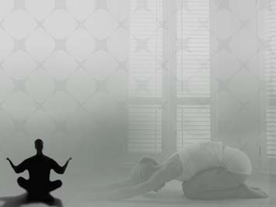
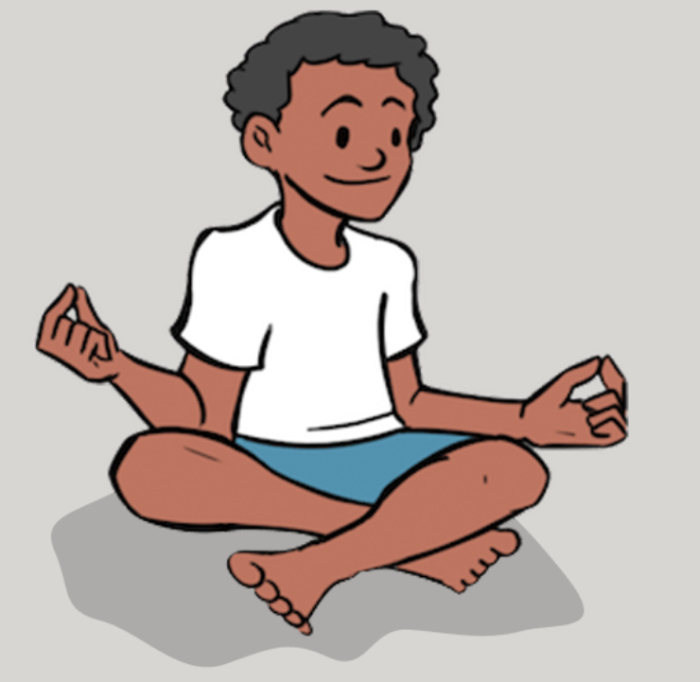
Yoga Vocabulary
quality
develop
notice
High lunge
calm
fluidity

Slide 4

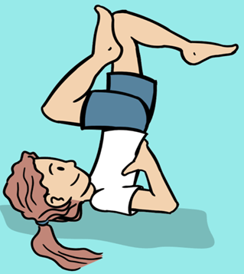
Gymnastics Vocabulary
asymmetrical
canon
aesthetics
rotation
progression
synchronisation
symmetrical

Slide 5

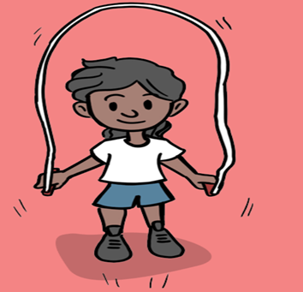
Fitness Vocabulary
momentum
power
drive
agility
rhythm
technique

Slide 6

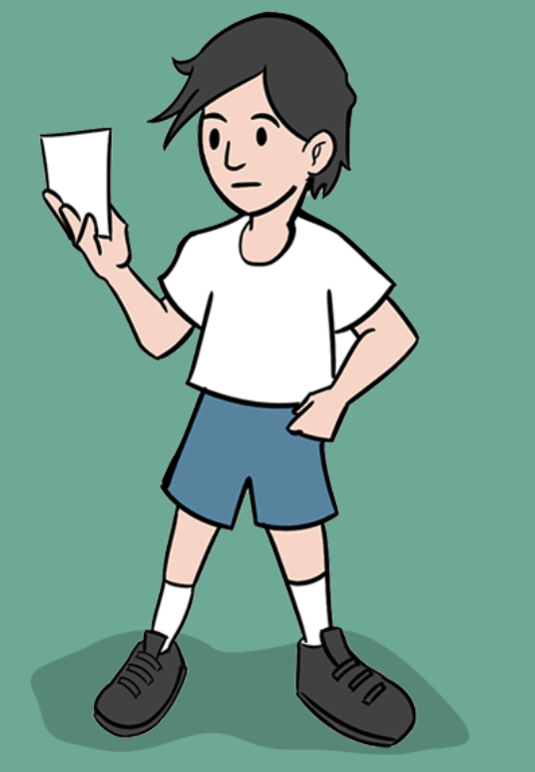
OAA Vocabulary
tactical
orienteering
collaborate
collective
Control card
navigation

Slide 7
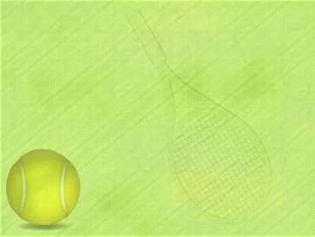
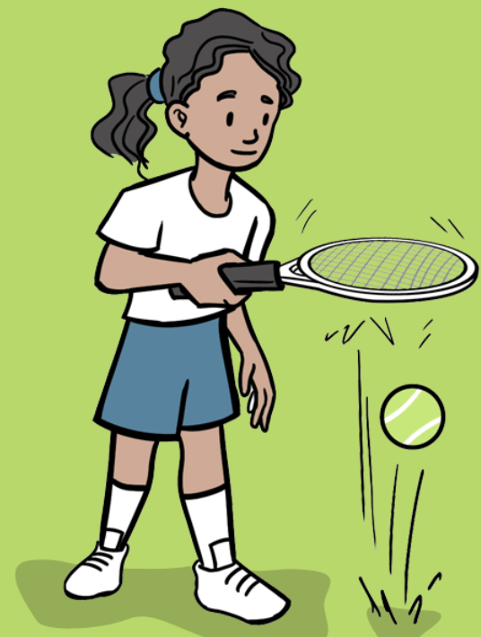
Tennis Vocabulary

Slide 8
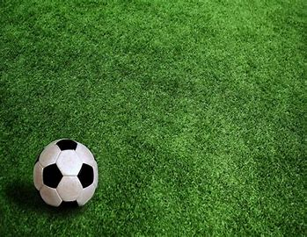
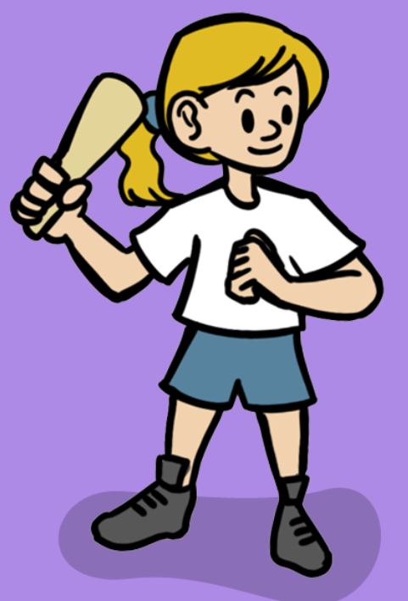
Rounders Vocabulary

Slide 9

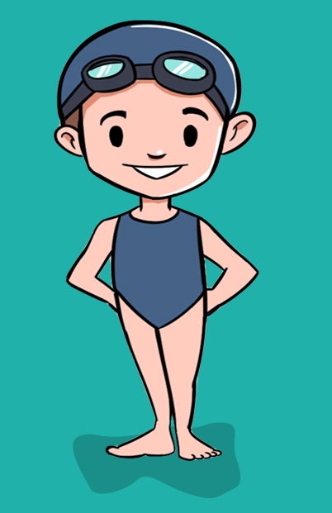
Swimming Vocabulary
breaststroke
crawl
backstroke
propel
Flutter kick
survival
submersion
synchronised
endurance
Treading water

Slide 10
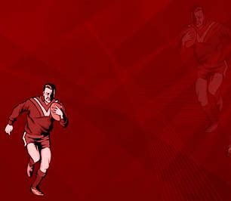
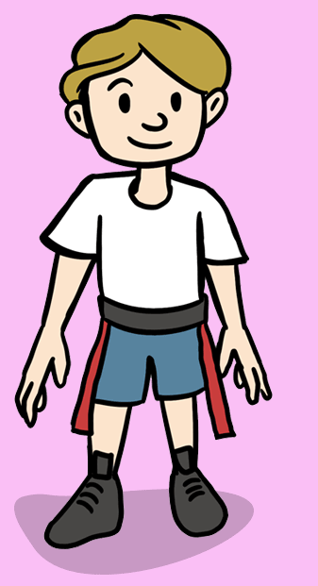
Tag Rugby Vocabulary

Slide 11
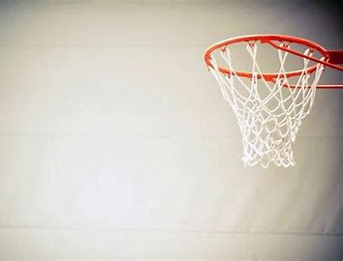
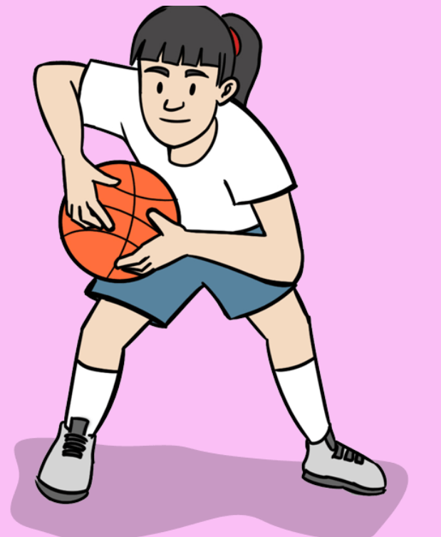
Basketball Vocabulary

Slide 12
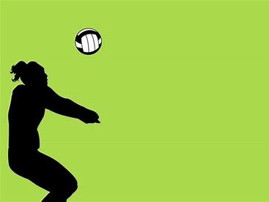
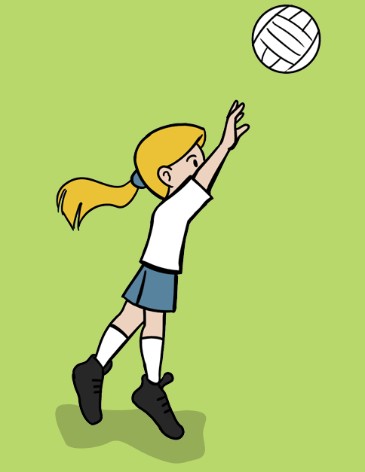
Volleyball Vocabulary

Slide 13
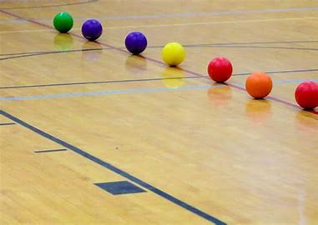
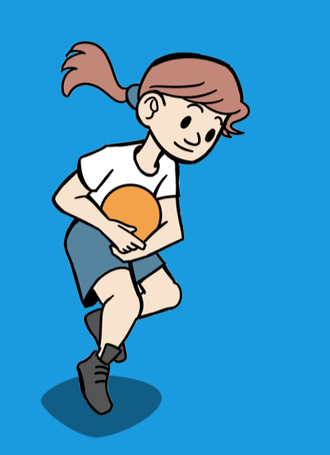
Dodeball Vocabulary

Slide 14

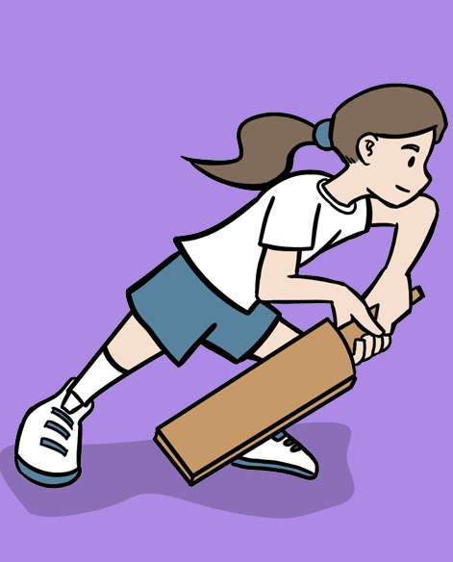
Cricket Vocabulary
strike
technique
retrieve
bowl
Wicket keeper
stumped
runs
Two handed pick up

