Slide 1

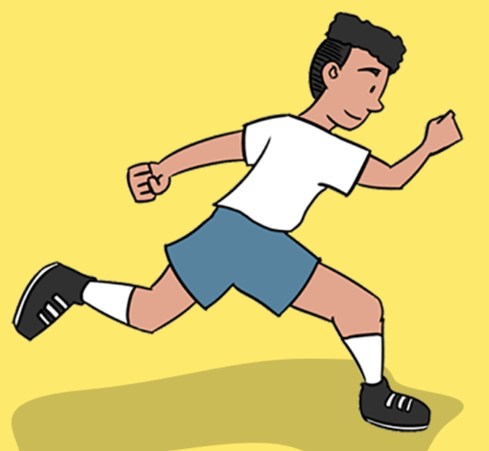
Athletics Vocabulary
power
higher
speed
strength
control
pace
accurately
faster
further

Slide 2
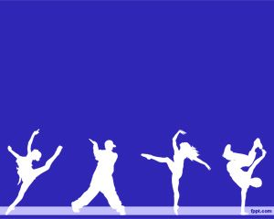
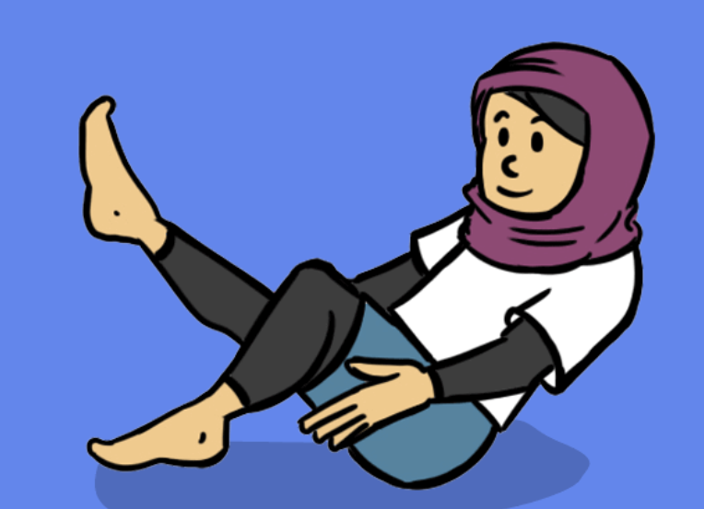
Dance Vocabulary
expression
create
perform
match
explore
feedback
flow

Slide 3

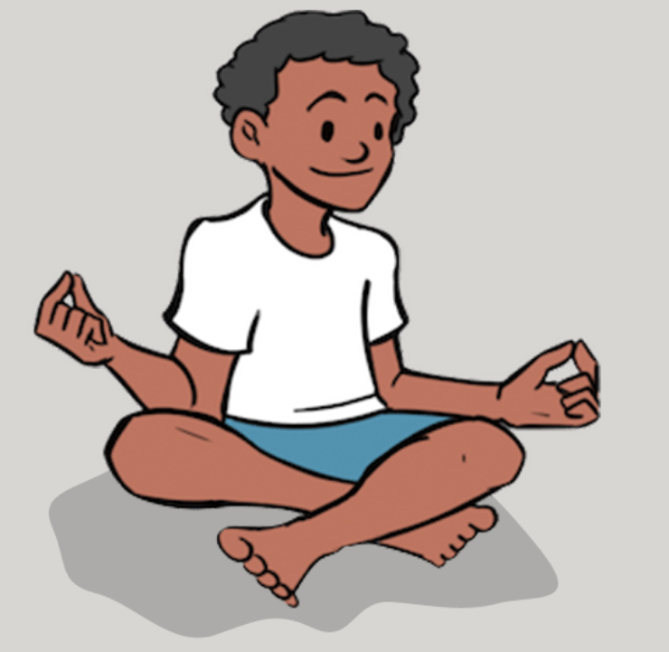
Yoga Vocabulary
perform
strength
try
Flexibility
link
technique

Slide 4

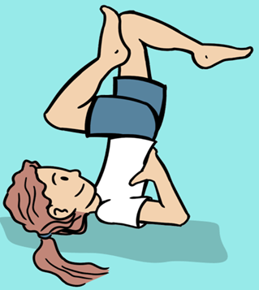
Gymnastics Vocabulary
control
contrasting
flow
create
explore
matching
interesting

Slide 5

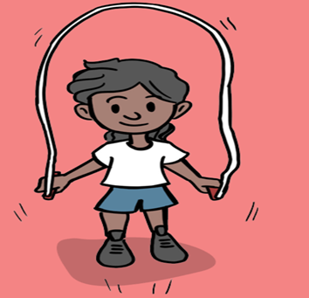
Fitness Vocabulary
control
strength
distance
balance
accurately

Slide 6

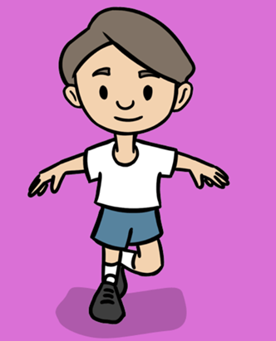
Fundamentals Vocabulary
distance
control
tension
coordination
technique
rhythm

Slide 7

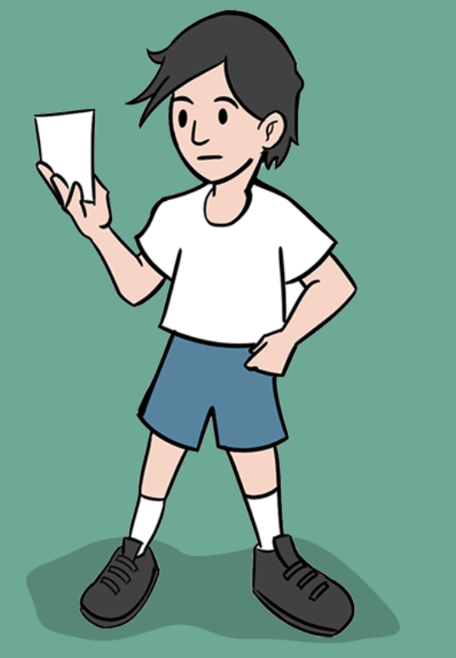
OAA Vocabulary
rules
grid
trust
route
plan
navigate
discuss

Slide 8
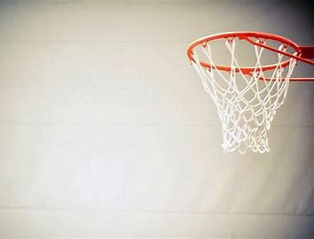
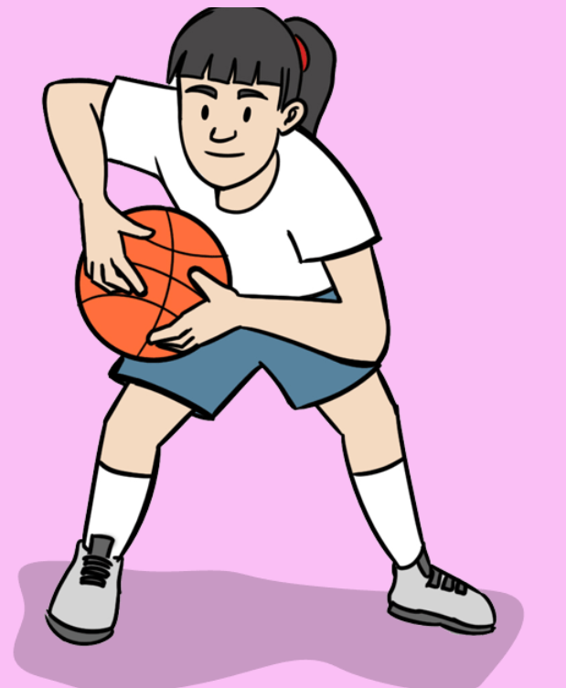
Basketball Vocabulary

Slide 9
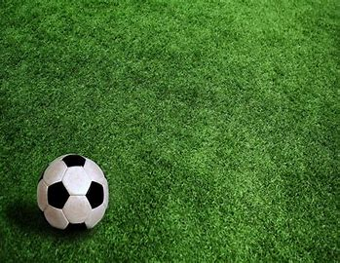
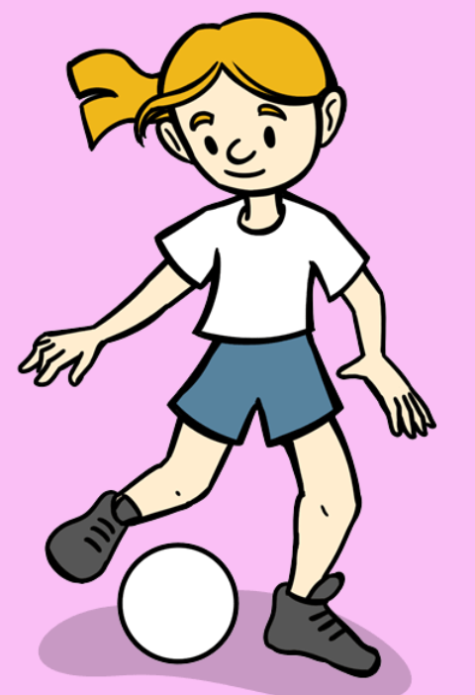
Football Vocabulary

Slide 10

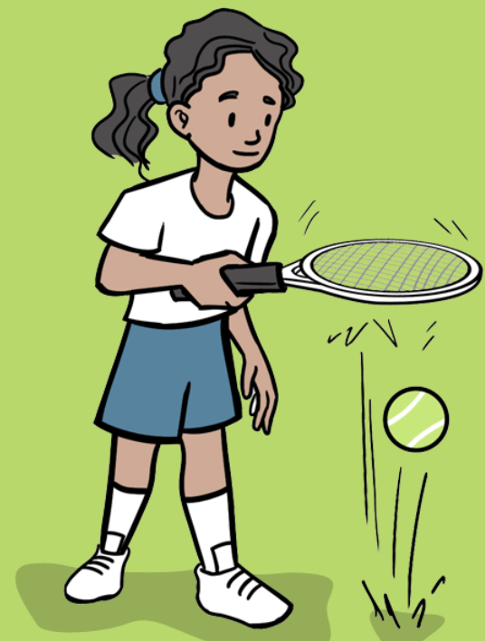
Tennis Vocabulary

Slide 11
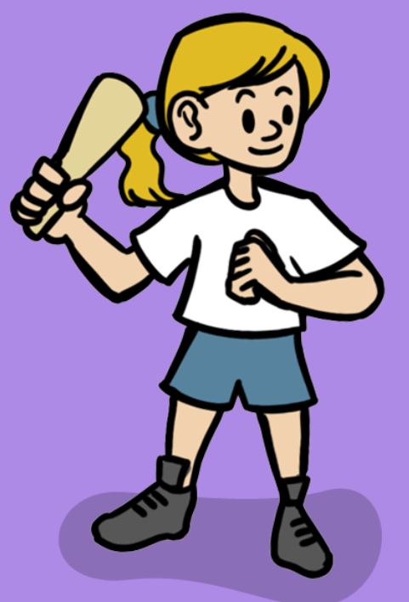
Rounders Vocabulary

Slide 12
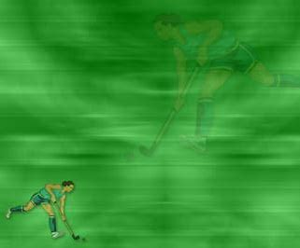
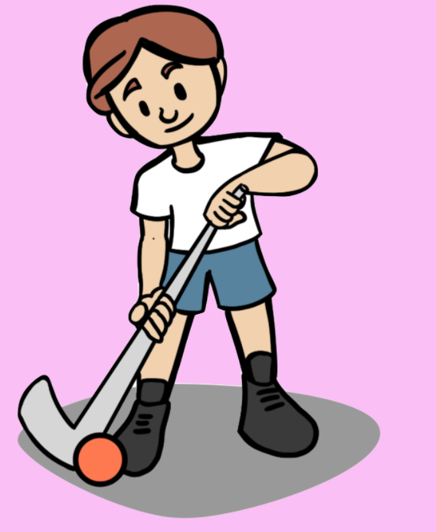
Hockey Vocabulary

