Slide 1

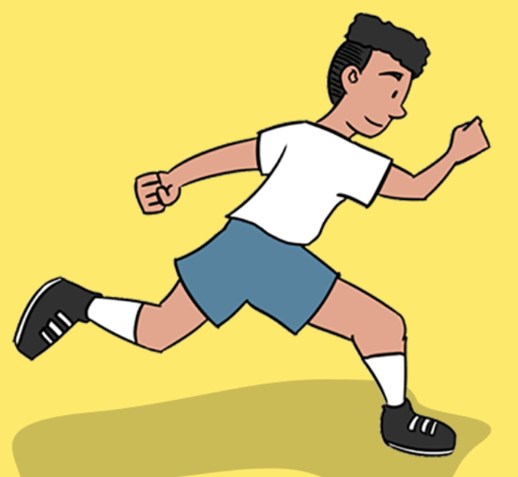
Athletics Vocabulary
power
stamina
accuracy
officiate
pace
determination
perseverance
Personal best

Slide 2
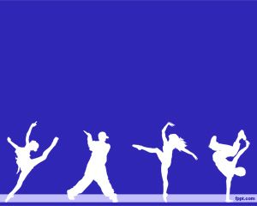
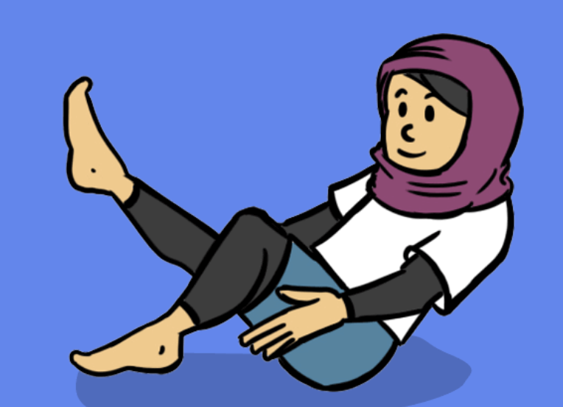
Dance Vocabulary
represent
unison
reaction
dynamics
control

Slide 3
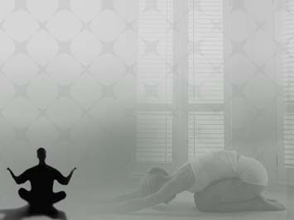
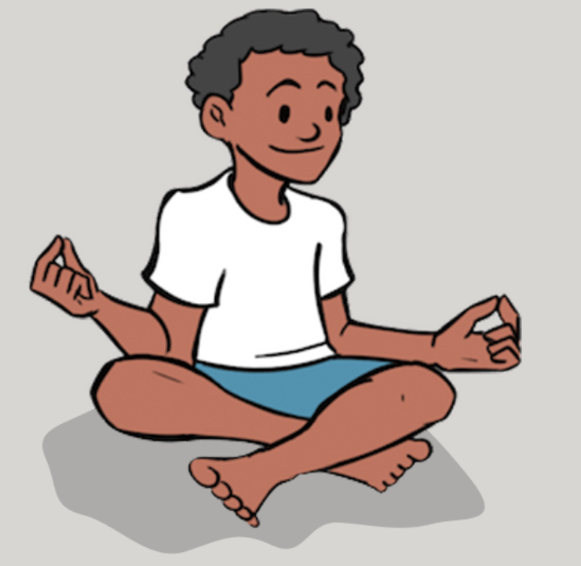
Yoga Vocabulary
grounded
Down dog
relax
mindfulness
control
stable

Slide 4

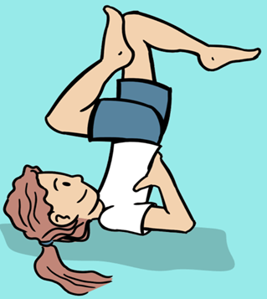
Gymnastics Vocabulary
technique
quality
perform
inverted
extension
apparatus

Slide 5

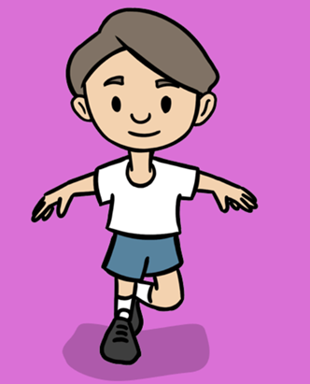
Fundamentals Vocabulary
decelerate
stability
transfer
accelerate
momentum
pace

Slide 6

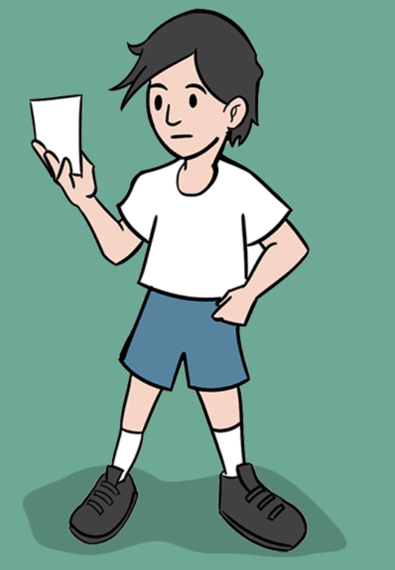
OAA Vocabulary
leader
inclusive
effectively
symbol
orientate

Slide 7
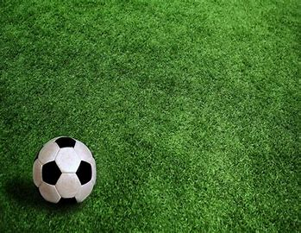
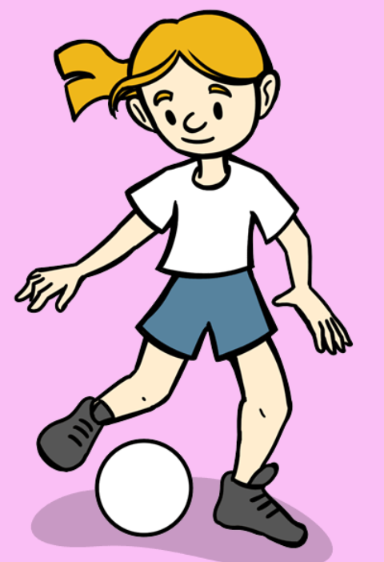
Football Vocabulary

Slide 8
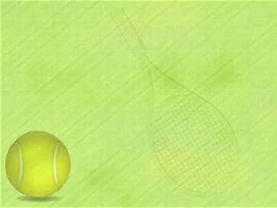
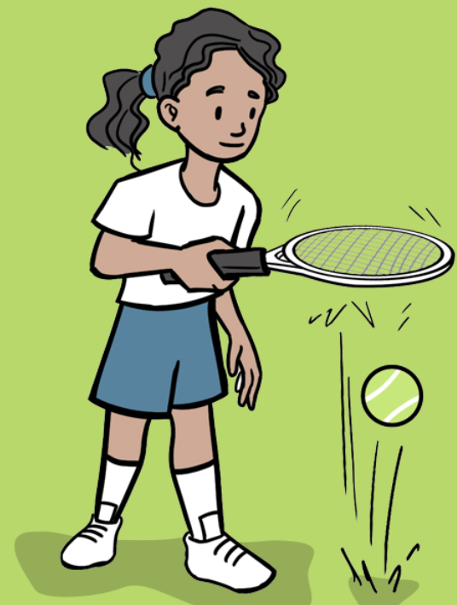
Tennis Vocabulary

Slide 9

Rounders Vocabulary

Slide 10
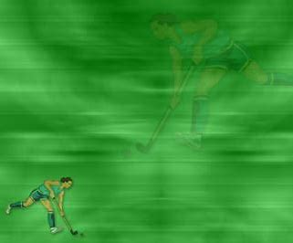
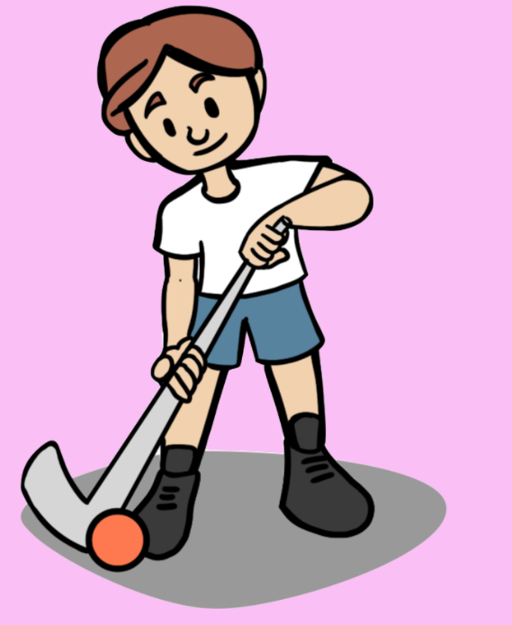
Hockey Vocabulary

Slide 11


Swimming Vocabulary
breaststroke
crawl
sculling
backstroke
survival
submersion
Treading water

Slide 12
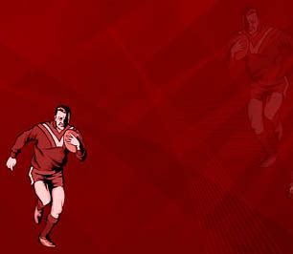
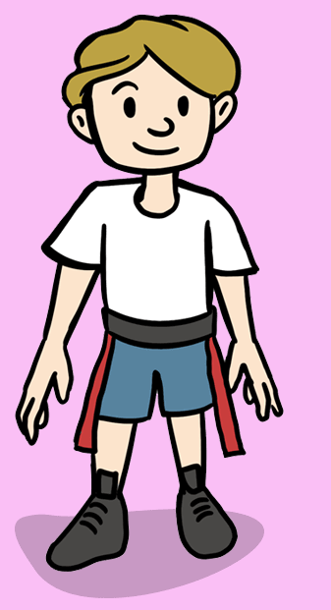
Tag Rugby Vocabulary

Slide 13
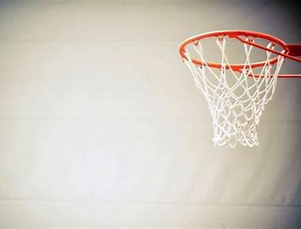
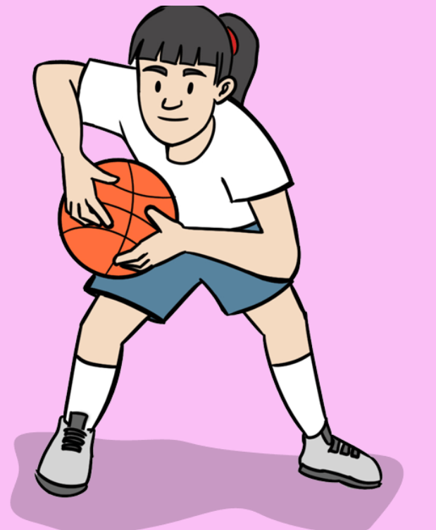
Basketball Vocabulary

