Slide 1


Ball skills Vocabulary
throw
catch
roll
stop
run
throw
kick
team

Slide 2

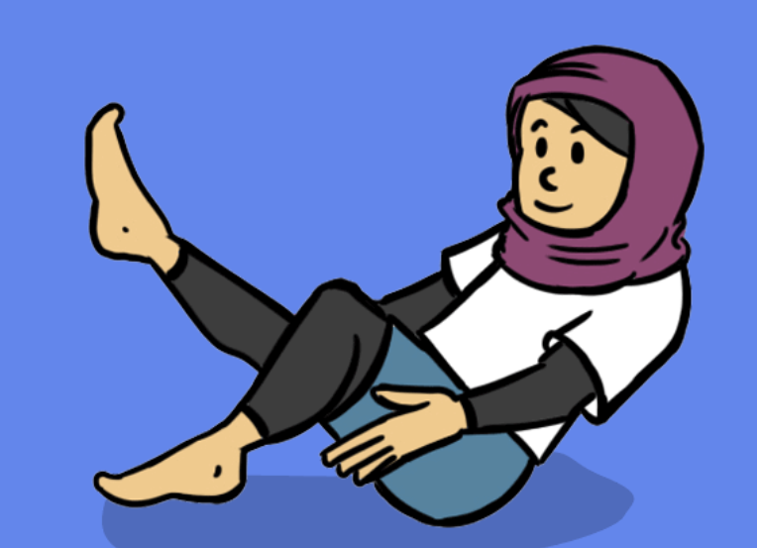
Dance Vocabulary
move
shape
copy
forwards
space
travel
safely
backwards

Slide 3

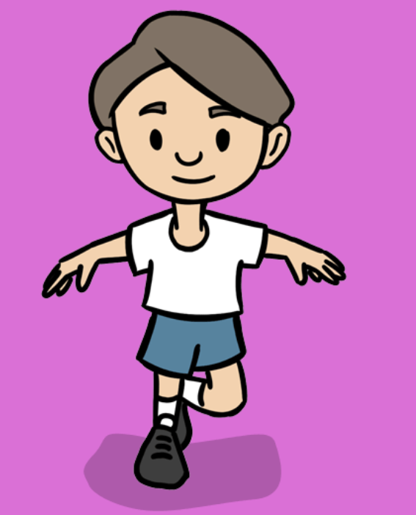
Fundamentals Vocabulary
run
stop
space
jump
skip
balance

Slide 4

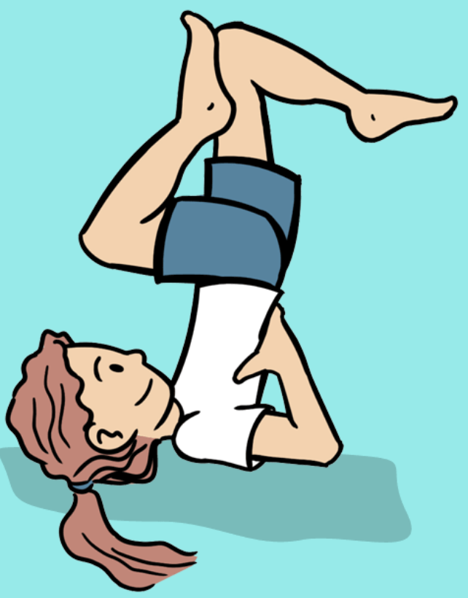
Gymnastics Vocabulary
shape
rock
space
travel
move
safely
copy
around
sideways

Slide 5

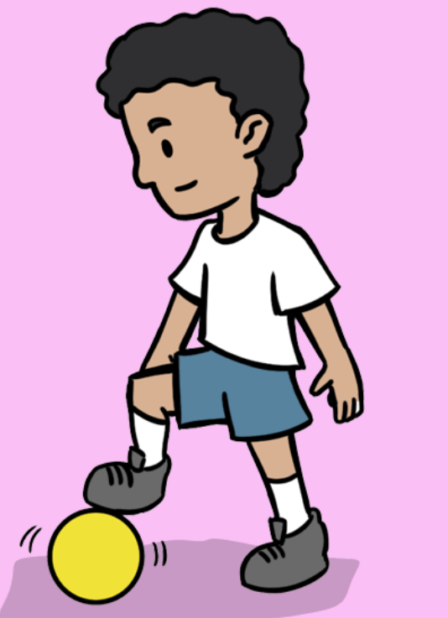
Games Vocabulary
pass
forwards
team
safely
tag
space
balance
backwards

Slide 6


Introduction to PE Vocabulary
pass
catch
jump
roll
throw
run

