Slide 1

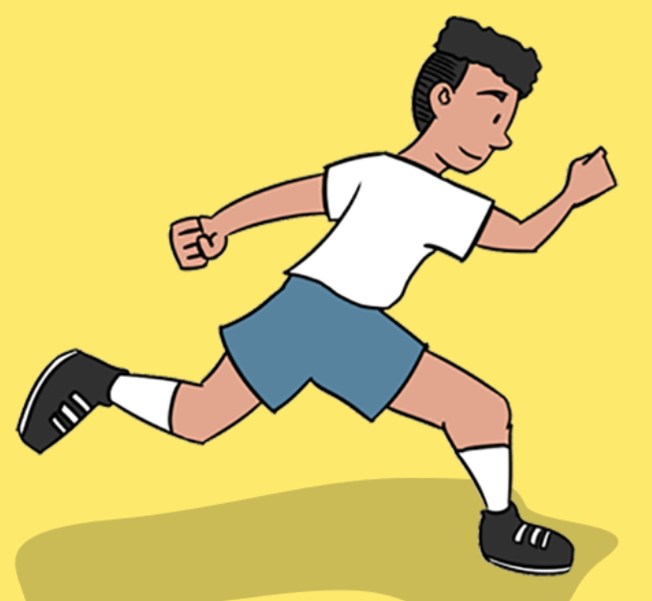
Athletics Vocabulary
takeoff
jog
sprint
hieght
landing
underarm
overarm
distance

Slide 2


Ball skills Vocabulary
overarm
collect
dribble
target
underarm
distance

Slide 3

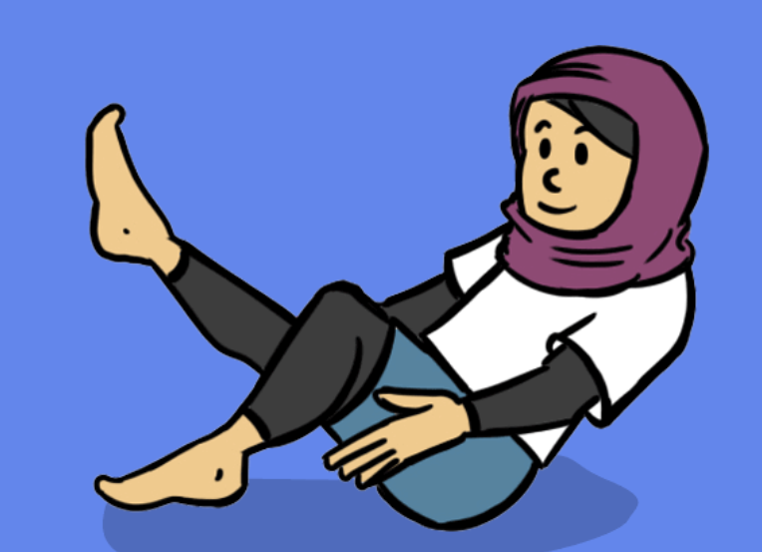
Dance Vocabulary
mirror
direction
speed
action
pathway
timing

Slide 4

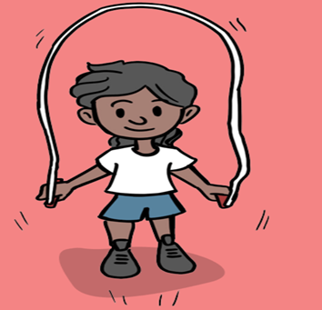
Fitness Vocabulary
jog
sprint
speed
pace
steady
strong
race

Slide 5

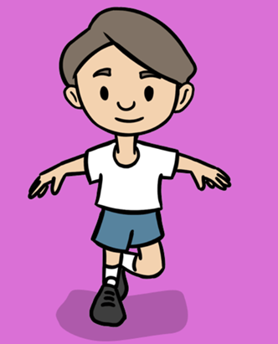
Fundamentals Vocabulary
dodge
steady
speed
sprint
jog
hurdle

Slide 6

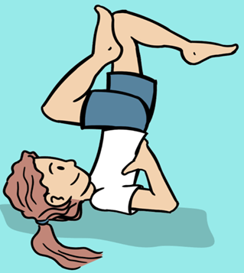

Gymnastics Vocabulary
tuck
pike
link
speed
straddle
sequence
pathway

Slide 7

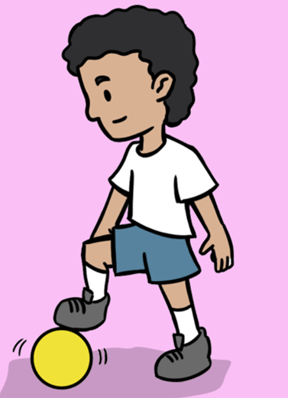
Invasion games Vocabulary
received
possession
goal
send
teammate
dodge
Bounce pass
Chest pass

Slide 8

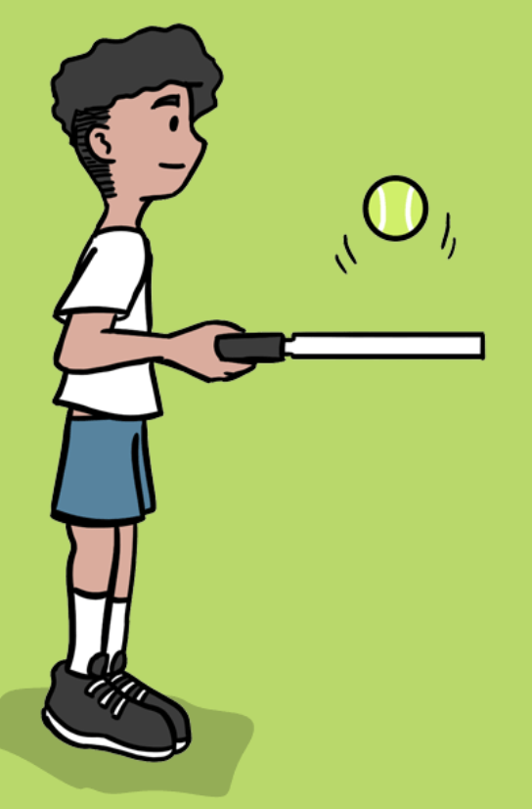
Net and wall games Vocabulary
quickly
receive
against
defend
trap
attack
return

Slide 9

Striking and fielding games
vocabulary
points
catch
target
hit
throw
score

Slide 10


Yoga Vocabulary
position
focus
choose
flow
pose
create

Slide 11

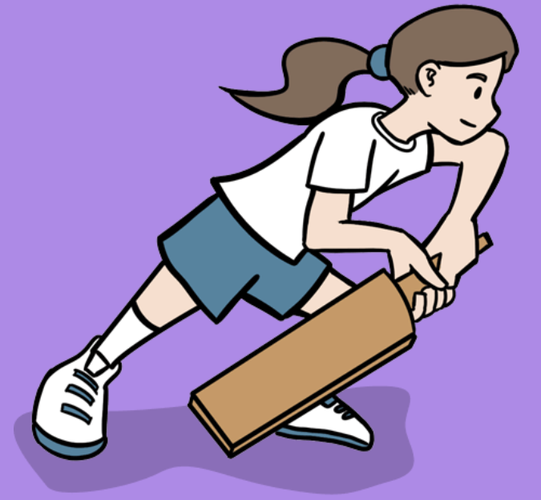
Cricket Vocabulary
batting
bowling
wicket
runs
technique
fielding

Slide 12

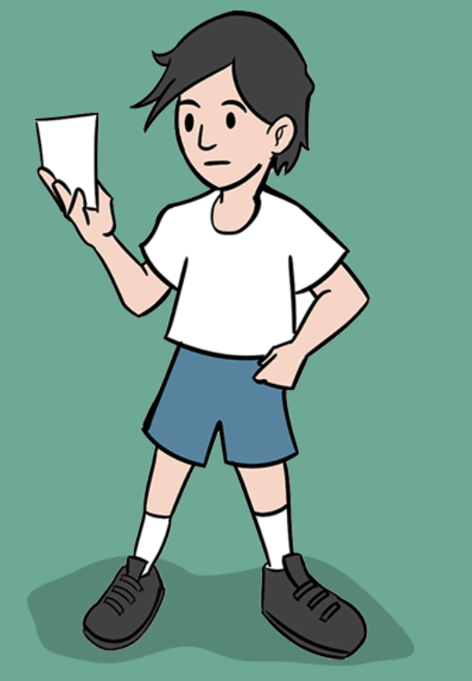
Team building Vocabulary
direction
successful
cooperate
support
communicate

