Slide 1


Athletics Vocabulary
direction
hop
far
improve
fast
slow
bend
travel
aim

Slide 2


Ball skills Vocabulary
far
direction
send
aim
balance
safely

Slide 3

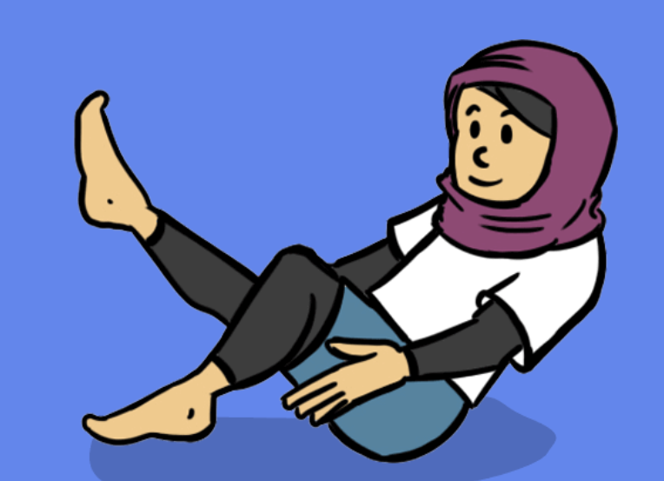
Dance Vocabulary
counts
levels
pose
slow
balance
fast

Slide 4

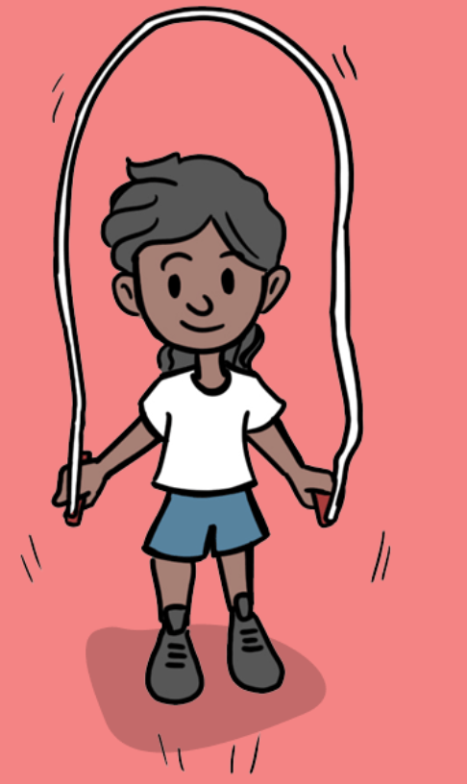
Fitness Vocabulary
slow
balance
jump
fast
direction
hop

Slide 5

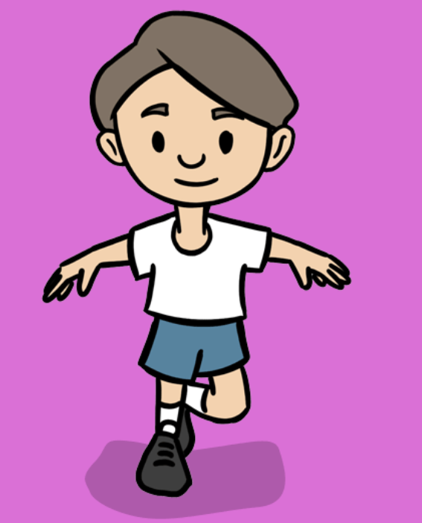
Fundamentals Vocabulary
direction
slow
land
fast
hop
safely

Slide 6

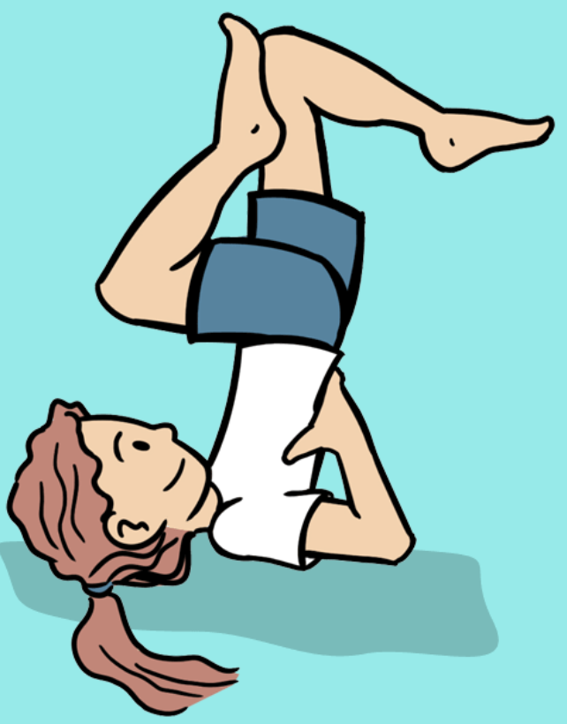
Gymnastics Vocabulary
jump
role
action
level
speed
point
direction
balance

Slide 7

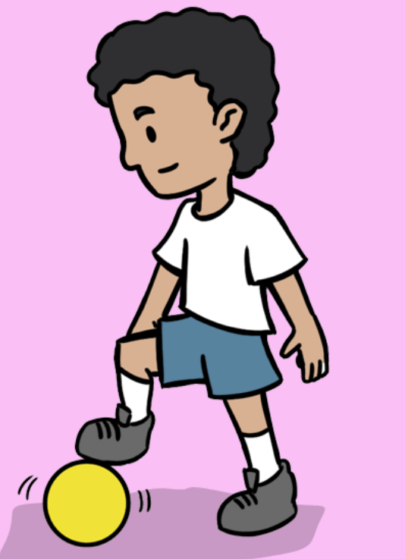
Invasion games Vocabulary
defender
dribbling
score
points
attacker
partner

Slide 8

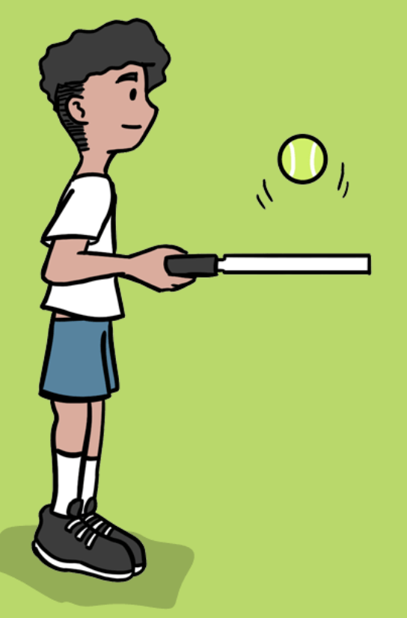
Net and wall games Vocabulary
partner
position
net
ready
score
point
underarm

Slide 9

Striking and fielding games
vocabulary
points
catch
target
hit
throw
score

Slide 10


Yoga Vocabulary
pose
breath
copy
listen
feel
slowly

Slide 11

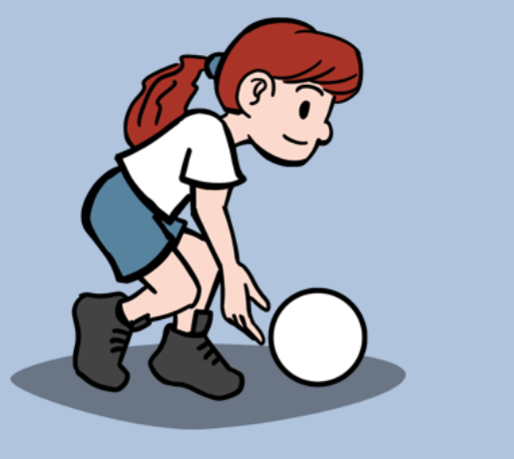
Sending and receiving Vocabulary
distance
throw
score
far
partner
points

Slide 12

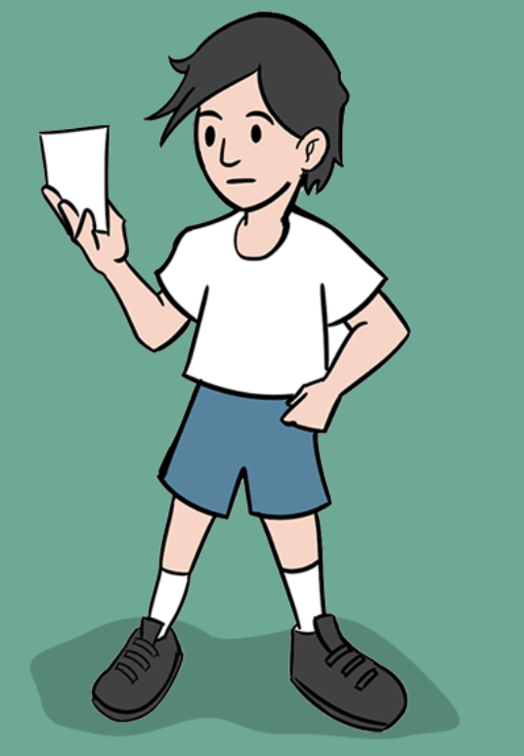
Team building Vocabulary
solve
teamwork
cooperate
lead
instructions

